Slide 1
Theory of Automata
Shakir Ullah Shah
Lecture 4

Slide 2
Languages Associated with Regular Expressions

Slide 3
Regular Languages
The language generated by any regular expression is called a regular language.
It is to be noted that if r₁, r₂ are regular expressions, corresponding to the languages L₁ and L₂ then the languages generated by r₁ + r₂ , r₁r₂ ( or r₂ r₁) and r₁*( or r₂*) are also regular languages.

Slide 4
Note
It is to be noted that if L₁ and L₂ are expressed by r₁ and r₂, respectively then the language expressed by
r₁+ r₂, is the language L₁+ L₂ or L₁ U L₂
r₁ r₂, , is the language L₁ L₂, of strings obtained by prefixing every string of L₁ with every string of L₂
r₁*, is the language L₁*, of strings obtained by concatenating the strings of L, including the null string.

Slide 5
Rules for language association with R.E’s
Rule 1:
The language associated with the regular expression that is just a single letter is that one-letter word alone, and the language associated with Ʌ is just {Ʌ}, a one-word language.

Slide 6
Rules for language association with R.E’s
Rule 2:
If r₁ is a regular expression associated with the language L₁ and r₂ is a regular expression associated with the language L₂, then:
(i) The regular expression (r₁)(r₂) is associated with the product L₁L₂, that is the language L₁ times the language L₂:
language(r₁r₂) = L₁L₂

Slide 7
Rules for language association with R.E’s
Rule 2:
(ii) The regular expression r₁ + r₂ is associated with the language formed by the union of L₁ and L₂:
language(r₁ + r₂) = L₁ + L₂
(iii) The language associated with the regular expression (r₁)* is L₁*, the Kleene closure of the set L₁ as a set of words:
language(r₁*) = L₁*

Slide 8
Finite Languages Are Regular
Theorem 5:
If L is a finite language (a language with only finitely many words), then L can be defined by a regular expression.
In other words, all finite languages are regular.

Slide 9
Finite Languages Are Regular
Proof:
Let L be a finite language. To make one regular expression that defines L, we insert plus signs between all the words in L e.g.
L = {baa,abbba,bababa} is baa+abbba+bababa
Note:
This algorithm only works for finite languages because an infinite language would become a regular expression that is infinitely long, which is forbidden.

Slide 10
Finite Automata

Slide 11
Finite Automata
Also known as deterministic finite automaton (DFA), Finite State Automata (FSA) or simply FA
It is a simple language recognition device.
It is called deterministic because their operation is completely determined by their input.
Strings are fed into the device by means of an input tape, which is divided into squares, with one symbol inscribed in each tape square.

Slide 12
Finite Automata
It is used to determine whether a word does or does not belong to a Regular Language
User for defining a Regular Language
Used in Lexical Analyzers

Slide 13
Deterministic Finite Automaton
Input Tape
String
Output
“Accept”
or
“Reject”
Finite
Automaton

Slide 14
Input tape
a
b
a
a
b
b
a
b
Reading head
q₀
q₅
q₁
Finite control
q₄
q₂
q₃

Slide 15
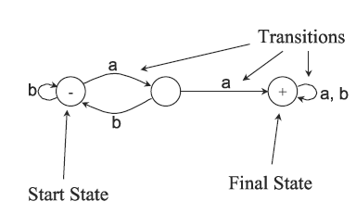
Notation

Slide 16
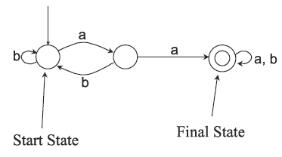
Alternative Notation

Slide 17
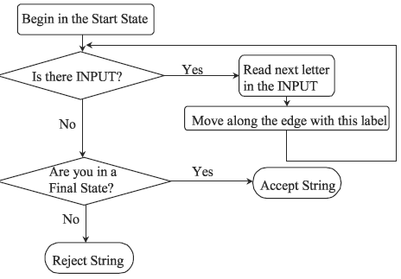
Flow Chart of FA

Slide 18
Initial Configuration
head
Input Tape
Input String
Initial state

Slide 19
Scanning the Input

Slide 22
Input finished
accept

Slide 23
Empty Tape
Input Finished
accept

Slide 24
Language Accepted:

Slide 25
Another Example
Alphabet:
Language Accepted:

Slide 26
Formal Definition
Deterministic Finite Automaton (DFA)
: set of states
: input alphabet
: transition function
: initial state (one)
: set of accepting states

Slide 27
Set of States
Example

Slide 28
Input Alphabet
Example

Slide 29
Initial State
Example

Slide 30
Set of Accepting States
Example

Slide 31
Transition Function
Describes the result of a transition
from state with symbol

Slide 32
Example:

Slide 35
Transition Table for
symbols
states

Slide 36
Extended Transition Function
Describes the resulting state
after scanning string from state

Slide 37
Example:

Slide 39
Special case:
for any state

Slide 40
In general:
implies that there is a walk of transitions
states may be repeated

Slide 41
Language Accepted by DFA
Language of DFA :
it is denoted as and contains
all the strings accepted by
We say that a language
is accepted (or recognized)
by DFA if

Slide 42
For a DFA
Language accepted by :

Slide 43
Language rejected by :

Slide 44
More DFA Examples
Empty language
All strings

Slide 45
Language of the empty string

Slide 46
= { all strings with prefix }
= { all strings that begins with ab}
accept

Slide 47
Infinite Languages
Example: Σ = {a,b}
L = {s :|s| is odd}
a,b
q₀
q₁
a,b

Slide 48
= { all binary strings containing
substring }

Slide 49
= { all binary strings without
substring }

